Slide 1

Project Title - Seasonal Agriculture Performance Analysis
Student Name – Sibham Maity
College Name- Jecrc University
AICTE STU ID : STU6a27e1c3417531780998595

Slide 2

PROBLEM STATEMENT
(Agricultural activities are influenced by seasonal variations in environmental conditions, farming practices, resource availability and market conditions. As a result, agricultural performance may differ from one season to another. However, raw agricultural data does not clearly explain how agricultural performance changes across seasons or what patterns can be observed in different seasonal conditions. The problem is to analyze the given agricultural dataset and investigate seasonal differences in agricultural performance by identifying meaningful patterns, trends, relationships and variations within the available data.

Slide 3
Project Description
This project presents a data-driven analysis of agricultural performance across different seasons (Kharif, Rabi, and Zaid) using a comprehensive dataset of 4,000 farming records. Agricultural outcomes are heavily influenced by seasonal variations in environmental conditions, resource availability, and farming practices. The primary objective is to process and analyze this raw data to uncover meaningful patterns, trends, and relationships regarding crop yield, resource usage (such as water and fertilizers), and overall economic profitability.
By utilizing Python-based data analytics and visualization techniques, this study highlights critical seasonal contrasts—such as the economic viability of the Kharif season compared to the high resource strain of the Zaid season. Ultimately, the insights derived from this analysis aim to support evidence-based agricultural planning, helping stakeholders optimize resource allocation and improve seasonal farming strategies.

Slide 4

WHO ARE THE END USERS?
Farmers & Agricultural Producers
Agricultural Planners & Policymakers
Agricultural Economists & Researchers
Agri-Tech Companies

Slide 5

Technology Used
  PYTHON
  PANDAS
  NUMPY
  MATPLOTLIB
  SEABORN
  JUPYTER NOTEBOOK
  GIT AND GITHUB

Slide 6
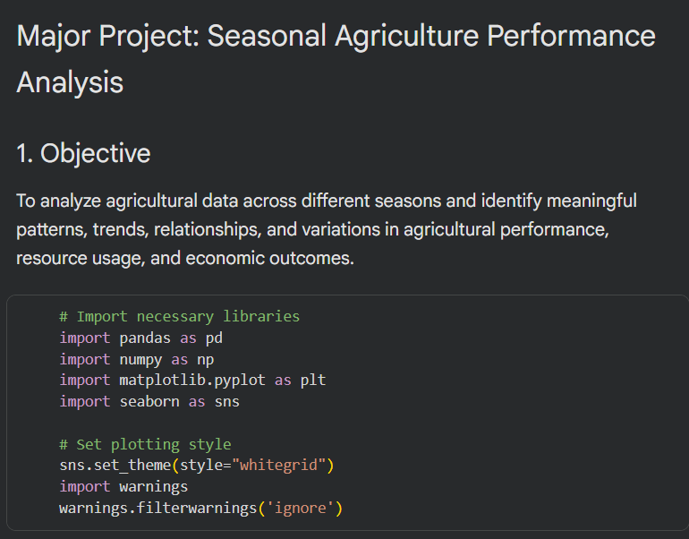
RESULTS

Slide 7
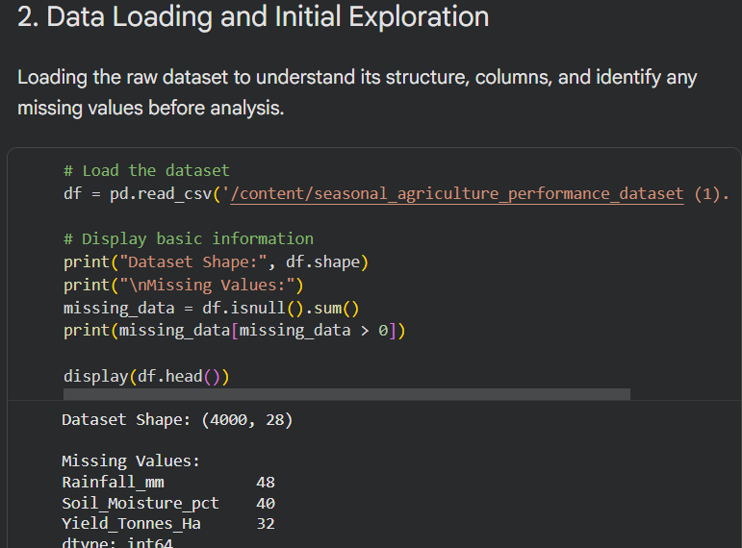
RESULTS

Slide 8
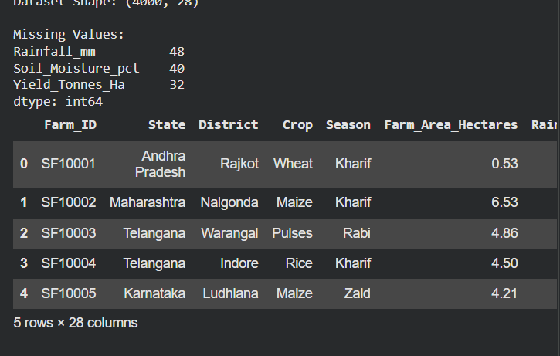
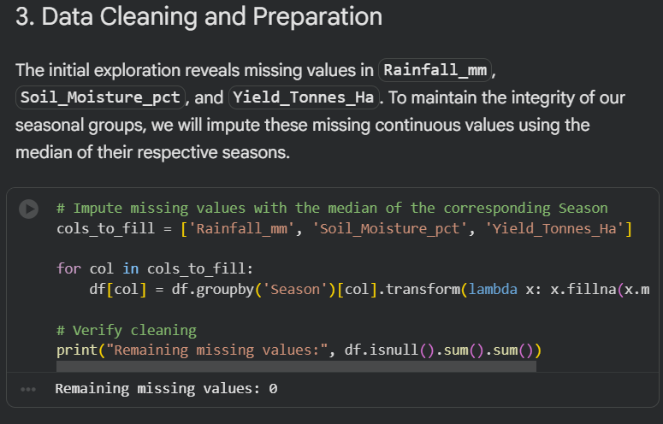
RESULTS
[Add screen shots of your code ]

Slide 9
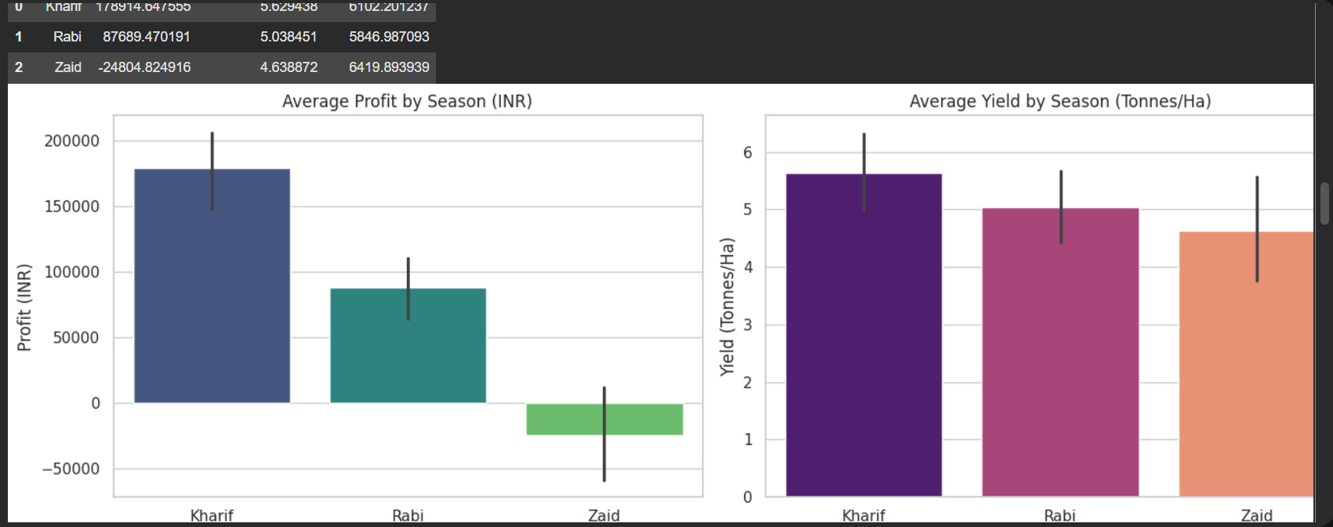
RESULTS
[Add screen shots of your code ]

Slide 10
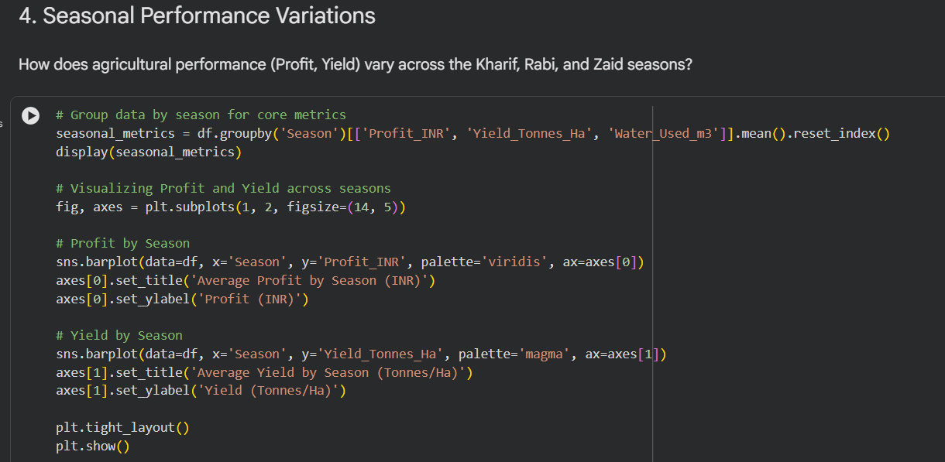
RESULTS

Slide 11
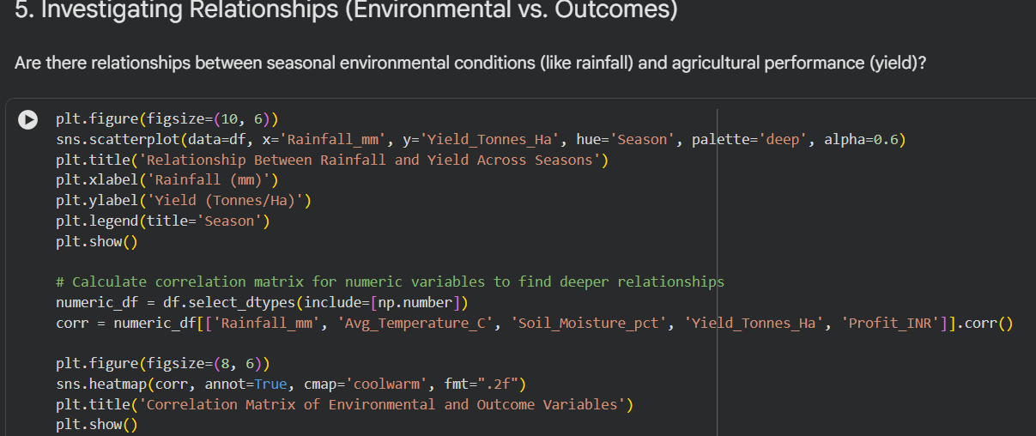
RESULTS

Slide 12
RESULTS

Slide 13
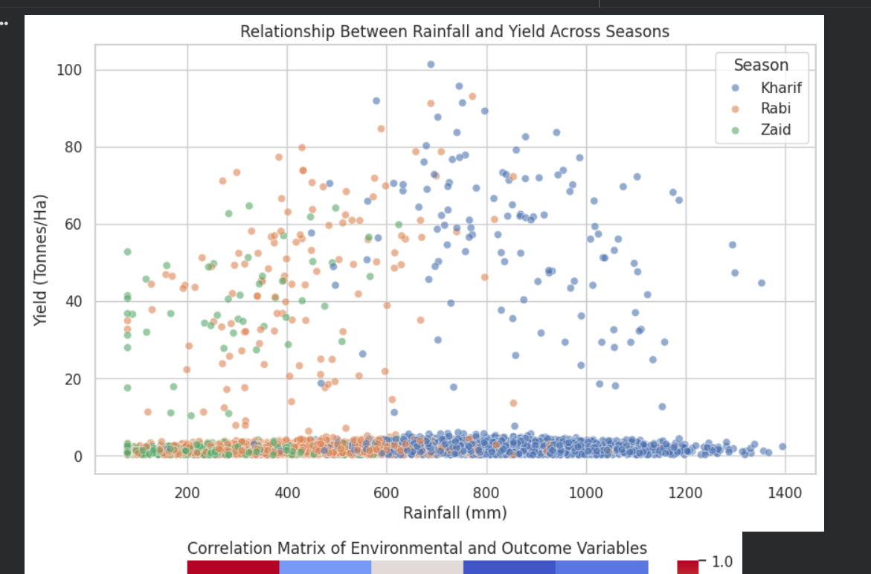
RESULTS

Slide 14
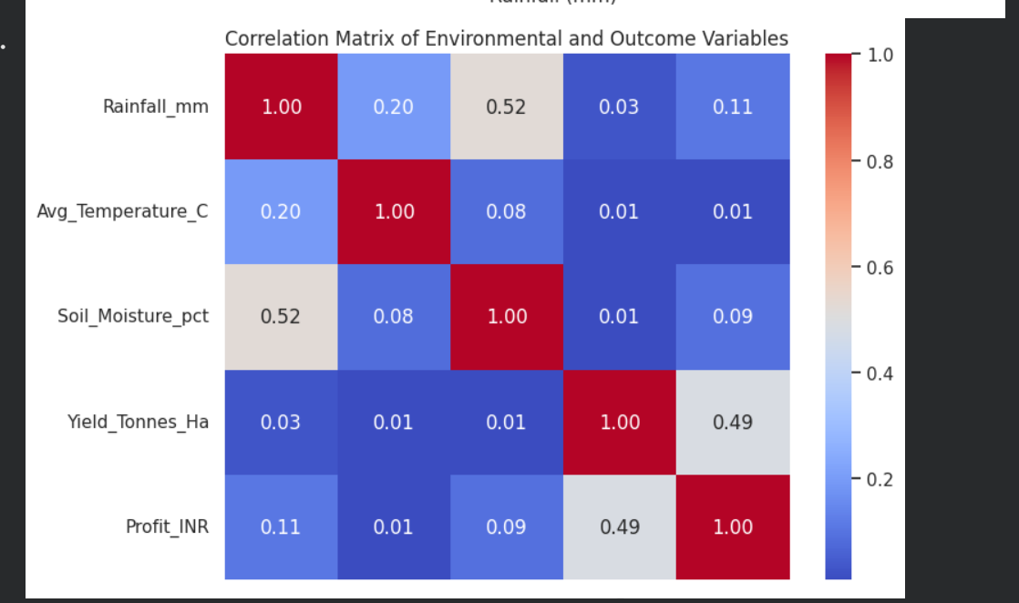
RESULTS

Slide 15
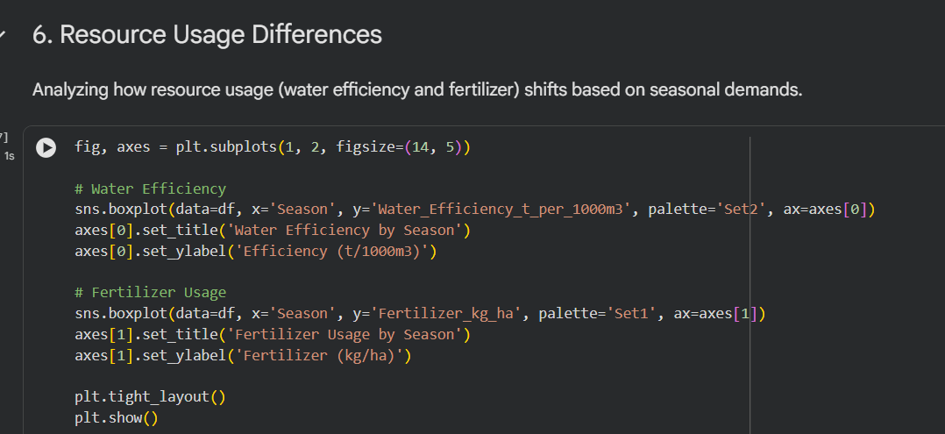
RESULTS

Slide 16
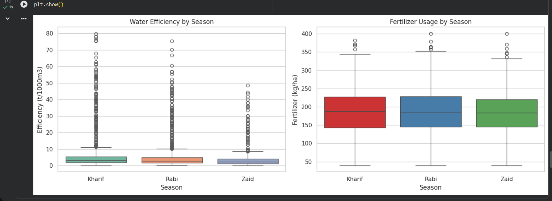
RESULTS

Slide 17
Future scope
*Predictive Machine Learning Models:Developing algorithms to forecast crop yields and market prices based on seasonal weather patterns and soil data.
* Real-Time Interactive Dashboards: Integrating the analysis into Power BI or Tableau for dynamic, real-time agricultural monitoring.
* Crop & Resource Recommender System: Creating an AI-driven tool to suggest the most profitable crops and optimal fertilizer/water usage for specific seasons and regions.
* Climate Change Impact Analysis: Expanding the dataset to analyze long-term climate shifts and their extended impact on seasonal farming viability.

Slide 18
GitHub Link
Sibham/Seasonal-Agriculture-Performance-Analysis
https://github.com/Sibham/Seasonal-Agriculture-Performance-Analysis.git

Slide 19
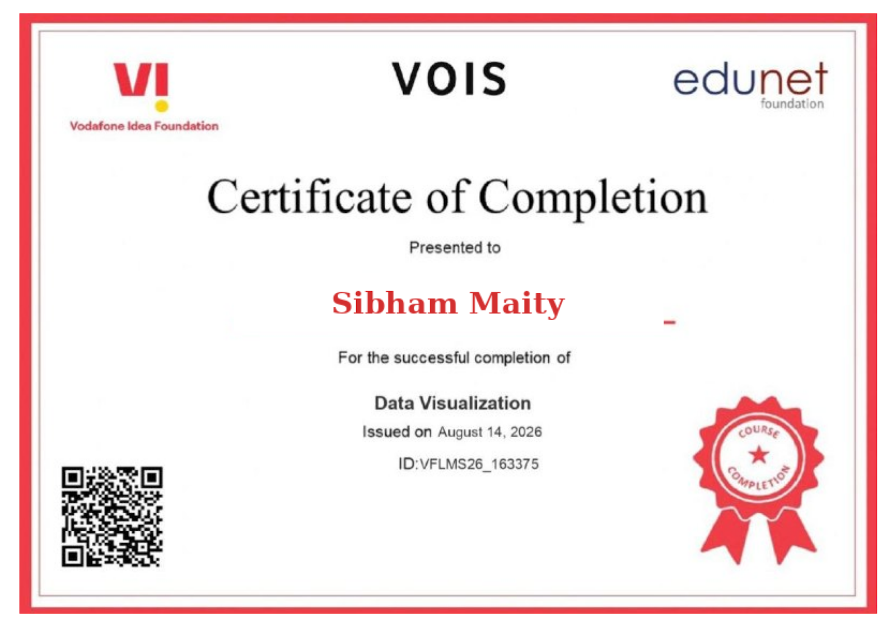
VOIS Course completion certificate -
Course name- Data Visualization

Slide 20
Thank you
.
.

